Slide 1
Risk Management
Application Security Testing

Slide 2
Project Risks
What can go wrong?
What is the likelihood?
What will the damage be?
What can we do about it?

Slide 3
Defining Risk
Definitions
  Risk is potential for realization of unwanted negative consequences of an event (Rowe William 1988)
  Risk is the measure of the probability of and severity of adverse effects (Lawrence 1976)
  Risk is the possibility of suffering loss, injury, disadvantage or destruction.(Webster 1981)
  Risk is the possibility of suffering loss (SEI)
Many definitions, no universally accepted definition
Common characteristics
  Uncertainty – An event may or may not happen
  Loss – an event has unwanted consequences or losses

Slide 4
Stating Risk
Two conditions
  A description of the current conditions that may lead to loss
  A description of the loss
“You Must Actively Attack a Project’s Risks, Otherwise They Will Actively Attack You.”- Grady Booch

Slide 5
Reactive Risk Management
  project team reacts to risks when they occur
  mitigation—plan for additional resources in anticipation of fire fighting
  fix on failure—resource are found and applied when the risk strikes
  crisis management—failure does not respond to applied resources and project is in jeopardy

Slide 6
Proactive Risk Management
formal risk analysis is performed
organization corrects the root causes of risk
  TQM concepts and statistical SQA
  examining risk sources that lie beyond the bounds of the software
  developing the skill to manage change

Slide 7
Risk Management Principles
Global perspective
Forward looking View
Open communication
Integrated management
Continuous process
Shared product vision
Working cooperatively to achieve common goals

Slide 8
Risk Management Paradigm
control
track
RISK
identify
plan
analyze

Slide 9
Building the Risk Table
Estimate the probability of occurrence
Estimate the impact on the project on a scale of 1 to 5, where
  1 = low impact on project success
  5 = catastrophic impact on project success
sort the table by probability and impact

Slide 10
Risk Mitigation, Monitoring, and Management
mitigation—how can we avoid the risk?
monitoring—what factors can we track that will enable us to determine if the risk is becoming more or less likely?
management—what contingency plans do we have if the risk becomes a reality?

Slide 11
Risk Due to Product Size
Attributes that affect risk:
• estimated size of the product in LOC or FP?
• estimated size of product in number of programs,
files, transactions?
• percentage deviation in size of product from
average for previous products?
• size of database created or used by the product?
• number of users of the product?
• number of projected changes to the requirements
for the product? before delivery? after delivery?
• amount of reused software?

Slide 12
Risk Due to Business Impact
Attributes that affect risk:
• affect of this product on company revenue?
• visibility of this product by senior management?
• reasonableness of delivery deadline?
• number of customers who will use this product
• interoperability constraints
• amount and quality of product documentation that
must be produced and delivered to the customer?
• sophistication of end users?
• governmental constraints
• costs associated with late delivery?
• costs associated with a defective product?

Slide 13
Risks Due to the Customer
Questions that must be answered:
• Have you worked with the customer in the past?
• Does the customer have a solid idea of requirements?
• Has the customer agreed to spend time with you?
• Is the customer willing to participate in reviews?
• Is the customer technically sophisticated?
• Is the customer willing to let your people do their
job—that is, will the customer resist looking over your
shoulder during technically detailed work?
• Does the customer understand the software
engineering process?

Slide 14
Risks Due to Process Maturity
Questions that must be answered:
• Have you established a common process framework?
• Is it followed by project teams?
• Do you have management support for
software engineering
• Do you have a proactive approach to SQA?
• Do you conduct formal technical reviews?
• Are CASE tools used for analysis, design and
testing?
• Are the tools integrated with one another?
• Have document formats been established?

Slide 15
Technology Risks
Questions that must be answered:
• Is the technology new to your organization?
• Are new algorithms, I/O technology required?
• Is new or unproven hardware involved?
• Does the application interface with new software?
• Is a specialized user interface required?
• Is the application radically different?
• Are you using new software engineering methods?
• Are you using unconventional software development
methods, such as formal methods, AI-based approaches,
artificial neural networks?
• Are there significant performance constraints?
• Is there doubt the functionality requested is "do-able?"

Slide 16
Staff/People Risks
Questions that must be answered:
• Are the best people available?
• Does staff have the right skills?
• Are enough people available?
• Are staff committed for entire duration?
• Will some people work part time?
• Do staff have the right expectations?
• Have staff received necessary training?
• Will turnover among staff be low?

Slide 17
Recording Risk Information
Project: Embedded software for XYZ system
Risk type: schedule risk
Priority (1 low ... 5 critical): 4
Risk factor: Project completion will depend on tests which require
hardware component under development. Hardware component
delivery may be delayed
Probability: 60 %
Impact: Project completion will be delayed for each day that
hardware is unavailable for use in software testing
Monitoring approach:
Scheduled milestone reviews with hardware group
Contingency plan:
Modification of testing strategy to accommodate delay using
software simulation
Estimated resources: 6 additional person months beginning 7-1-96

Slide 18
Risk management
Risk management is concerned with identifying risks and drawing up plans to minimise their effect on a project
A risk is a probability that some adverse circumstance will occur
  Project risks affect schedule or resources
  Product risks affect the quality or performance of the software being developed
  Business risks affect the organisation developing or procuring the software

Slide 19
The risk management process (I)
Risk Assessment
Risk identification
  Identify project, product and business risks
  Historical database, Brainstorming, Checklists
Risk analysis
  Assess the likelihood and consequences of these risks (Probability and Impact)
Prioritise
Risk Control
Risk planning
  Draw up plans to avoid or minimise the effects of the risk, Reduce probability
Risk monitoring
  Monitor the risks throughout the project, Regular reviews, Status reporting
Resolution
  Track implementation, Review effectiveness, Re-assess risk

Slide 20
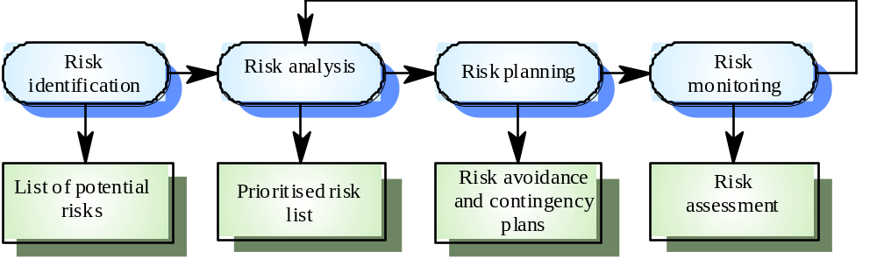
The risk management process (II)

Slide 21
Risk identification
Technology risks
People risks
Organisational risks
Tools risks
Requirements risks
Estimation risks

Slide 22
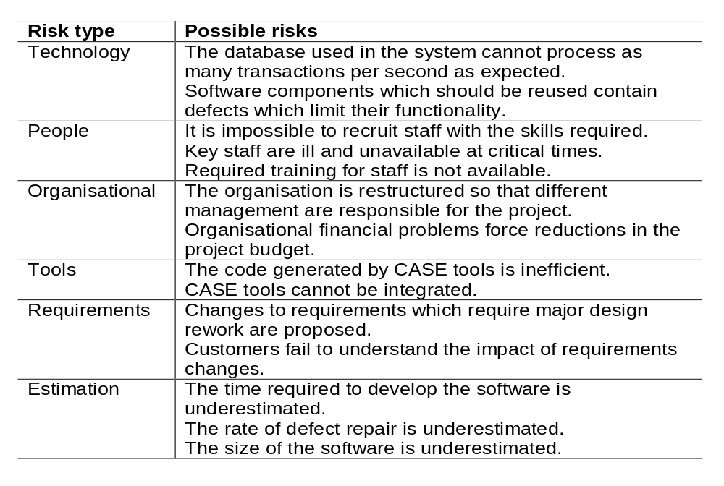
Risks and risk types

Slide 23
Risk analysis
Assess probability and seriousness of each risk
Probability may be very low, low, moderate, high or very high
Risk effects might be catastrophic, serious, tolerable or insignificant

Slide 24
Risk planning
Consider each risk and develop a strategy to manage it
Avoidance strategies
  Probability that the risk will arise is reduced
Minimisation strategies
  Impact of the risk on the project or product is reduced
Contingency plans
  If the risk arises, contingency plans are plans to deal with the risk

Slide 25
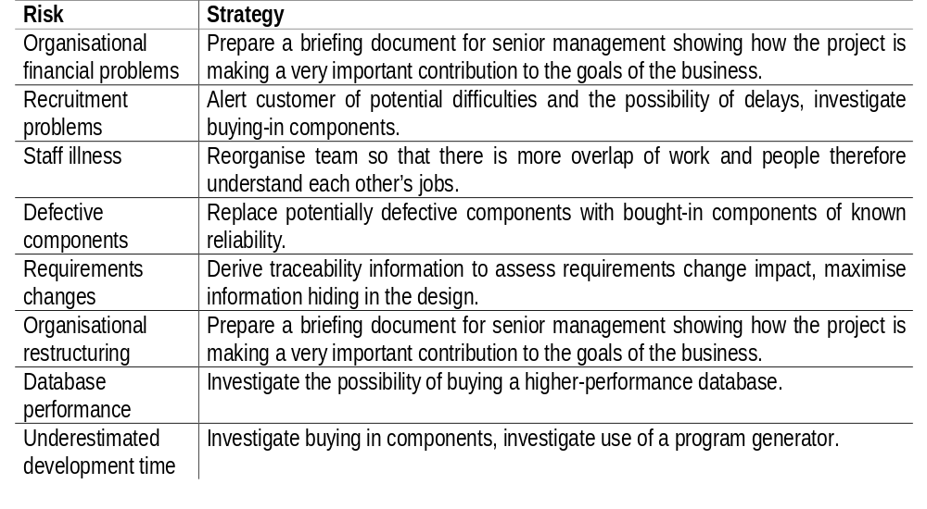
Risk management strategies

Slide 26
Risk monitoring
Assess each identified risks regularly to decide whether or not it is becoming less or more probable
Also assess whether the effects of the risk have changed
Each key risk should be discussed at management progress meetings

Slide 27
Good Practices
Acknowledgement that risks are inevitable
Communicate risks openly
Reward people who prevent crisis
Don’t try to manage too many risks at a time
Write down risks
Integrate risk management into project management
Don’t emphasize too much on quantification at the start
Don’t look at cost benefit analysis of implementing risk management
Remember that risk plan may introduce new risks or increase cost
Risk evasion should be the ‘last’ resort and should be done ‘consciously’
Use a risk database at an organization level
Don’t focus only on easy risks
Categorize risks

Slide 28
Key points (I)
Good project management is essential for project success
The intangible nature of software causes problems for management
Managers have diverse roles but their most significant activities are planning, estimating and scheduling
Planning and estimating are iterative processes which continue throughout the course of a project

Slide 29
Key points (II)
A project milestone is a predictable state where some formal report of progress is presented to management
Risks may be project risks, product risks, or business risks
Risk management is concerned with identifying risks which may affect the project and planning to ensure that these risks do not develop into major threats

Slide 30
Application Security Testing

Slide 31
Security TESTING
Attempts to verify that protection mechanisms built in to a system will in fact protect it from improper logins.
The tester plays the role of an individual who desires to hack the system.
The role of a system designer is to make the cost of hacking greater than the value of the the information that will be obtained

Slide 32
Why Web application security is important
Reduce cost of recovery and fixes
  Computer security attacks costs as much as $10 billion a year
Ensure Customer Trust
  Trust is a key component to customer adoption and retention
Ensure Website Adoption
  Customers are still not adopting websites as a preferred channel for doing business

Slide 33
Why Web application security is important
Maintain Competitive Advantage
  Many organizations are using trust as a key
  competitive advantage and are leveraging customer fears to proactively implement
  security and privacy programs to ease the uncertainty.

Slide 34
Seven Main types of Security Testing
Vulnerability Scanning
Security Scanning
Penetration Testing
Risk Assessment
Security Auditing
Ethical Hacking
Posture Assessment & Security Testing

Slide 35
Seven Main types of Security Testing
Vulnerability Scanning is using automated software to scan one or more systems against known vulnerability signatures.
Security Scanning is a Vulnerability Scan plus Manual verification. The Security Analyst will then identify network weaknesses and perform a customized professional analysis.
Penetration Testing takes a snapshot of the security on one machine, the “trophy”. The Tester will attempt to gain access to the trophy and prove his access, usually, by saving a file on the machine. It is a controlled and coordinated test with the client to ensure that no laws are broken during the test.

Slide 36
Seven Main types of Security Testing
Risk Assessment involves a security analysis of interviews compiled with research of business, legal, and industry justifications.
Security Auditing involves hands on internal inspection of Operating Systems and Applications, often via line-by-line inspection of the code.
Ethical Hacking is basically a number of Penetration Tests on a number of systems on a network segment.
Posture Assessment and Security Testing combine Security Scanning, Ethical Hacking and Risk Assessments to show an overall Security Posture of the organization.

Slide 37
How Hackers Get In
Browser-based attacks use flaws in the Web-based application code. Software most vulnerable to these types of attacks includes:
  User interface code -- provides the look and feel of the site
  Web server -- supports the physical communication between the user’s browser and the web applications
  Front-end applications-- interfaces directly with the user interface code, and backend systems

Slide 38
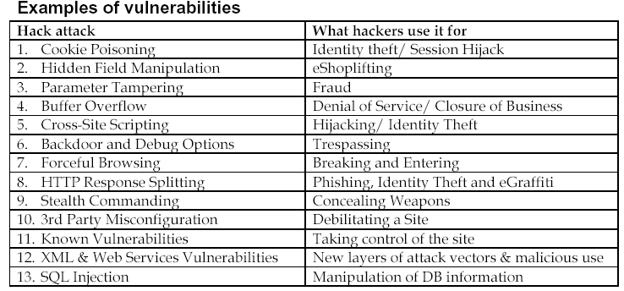

Slide 39
Security Threats
Input Validation
Access Control
Broken Account and Session Management
Cross-site scripting flaws
Buffer overflow
Command line injection
Error handling problems
Insecure use of cryptography
Web and application server mis-configuration
Database testing

Slide 40
Security Threat One - Input validation
Checking if there is any client side validation method is used. To do this, do “view source” and look for JavaScript, Java, VBScript etc, find out what they are doing.
Look for “input type="hidden"”; If you find one, change the parameters following this key, observe the server response.
If an application uses any 3rd party software or components, test if all inputs passed by 3rd party software is validated before use them.
It’s possible to send tainted parameter or manipulated input by using tools like netcat (free), Achilles (free), WebScarab (free), WebClient (free, a component for .Net), tcpreplay (free), Vugen for Load Runner ($) or WinRuner ($), SPIKE Proxy ($), WebInspect ($$), and AppSan ($$).

Slide 41
Security Threat Two - Access Control
Review the access rights assigned to all application users. Ensure “least privilege” rule is followed.
If application uses some form of id, key or index as a way to reference users, content, or function, the application should not rely on the secrecy of any id’s for protection, since an attacker can guess these id’s.
Take a look at what has been cached on the client computer after a web site testing. Users may access web applications from shared computers. Browser caching should be turned off for sensitive information
Go through the server boxes to ensure samples and default files are cleaned up.
Take a look at all the open ports of the testing target box. Understand the purpose of each exe running behind each listening ports.

Slide 42
Security Threat Two - Access Control (contd.)
Take a look at all the directories that can be seen from Internet. Most application vulnerability scanning tools, for example, WebInspect, AppScan, ISS scanner ($)… can do directory emulation by using a built in dictionary.
Manually browsing through paths reported by above directory emulation scan, verify only allowed paths can be seen. Browsing with relative path (e.g., “../../winnt/system32”) as part of a request.
Check that HTTPS is used when sending any none public information. When HTTP is used, everything go through the wire is in clear text.
If your web application requires user login, you can run a remote brute-force authentication cracker to verify that strong password algorithm is used and account lockouts policy is implemented.
Every attempt should be made to access every resource via every entry point.

Slide 43
Security Threat Three - Broken Account and Session Management
Start a session and login. Then leave the window open. Come back the second day, continue with a client side request. If you aren't prompt for login again, you need to submit a defect on no session timeout. This has to be test manually, no vulnerability scan tool for this.
If an application implements its own authentication methods, detail testing will need, for example, who is the Credentialing Authorities? Is SSL/TSL used when transmit none public data.
Logs out from your application after doing some work the app. Then click on the back button of the browser, (need to click it several times to trigger this).
Login your web app, select everything from the website and copy and paste to outlook new email and send out to another email address. The other person who receives the email will be able to access all the app's links. Can even submit a request on behalf of the login person! It could be caused with an app that is using session ID information stored within fields of a form.

Slide 44
Security Threat Four - Cross-Site Scripting (XSS) Flaws
Cross-Site Scripting (XSS) attacks require the execution of Client-Side Languages (JavaScript, Java, VBScript, ActiveX, Flash, etc.). XSS occurs when an attacker uses a web application to send malicious code to a different end user. The first defense is input validation, and the second defense is to HTML-encode all input when it is used as output.
Feed input with all the following chars: ‘<’, ‘>’, ‘(‘,’)’, ‘#’, ‘&’, and see if the output is filtered.
WebInspect, AppScan, Nessus, Nikto, and some other tools can help scan and identify XSS.

Slide 45
Security Threat Five - Buffer Overflow
If your application is coded with J2EE or .NET framework (application running within a VM sandbox), you are not vulnerable to buffer overflow vulnerability.
For applications developed in C, C++, Python, Perl and PHP, you should start with RATS or Flawfinder tool (free). The tool scans source code, finding potentially dangerous function calls.
The goal of this tool is not to definitively find bugs, but to provide a reasonable starting point for performing manual security audits
Other tools, such as NuMega Bounds Checker by Compuware is integrated with MS developer Studio. Stack Guard (www.immunix.org), Stack Shield (www.angelfire.com), SecureStack (www.securewave.com) for Linux are free stack execution prevent tools.

Slide 46
Security Threat Six - Command injection flaws
Majority of programming languages have system commands to aide their functionality. When user input is not adequately checked, it is possible to executing operating system commands. To test this vulnerability, you should test the input with all the OS commands that the server box is set up to support. You can file a defect for developers’ investigation if you get a HTTP 200 ok with an OS command input.

Slide 47
Security Threat Seven - Error Handling Problems
You should file a defect whenever you see a database error message is sent to an end user. Without a database error message, the application could still be vulnerable to blind sql attack, but the difficult level is much harder.
You should file a defect whenever application gives information reflects clues on potential flaws in the site. For example, a stack trace.
File a defect when you see inconsistencies in messages reveal important clues on how a site works, and what information is present under the covers.
You can download and plug InfoSec application security program developed Application Security Framework to help your application to log implementation flaws and hacking attempts.

Slide 48
Security Threat Eight – Insecure use of Cryptography
Verify that all cryptography use is compliance with HP Cryptography policy and standard (http://it.corp.hp.com/ea/app/polstd.aspx).
Ensure no customer encryption algorithm like this is in use: encrypt “security” into “xjhzwny~” (char = char +5).
With the policy and standard in place, a test engineer should also review how keys, passwords, and other secrets are stored, loaded, and processed, and cleared from memory by the application.

Slide 49
Security Threat Nine - Web and application server mis-configuration
Most of networks have deployed some sort of security patch update servers. For example, SUS or SMS
If the application run on top of some special middleware, which is not monitored by the SMS server, a test engineer need to do some researches on security watch dog sites: cert.org, sans.org, owasp.org, xforce.iss.net…
Walk through each box to ensure unnecessary default and sample files have been cleaned up. These include web server installation, application server installation, and middleware installation.
Verify FTP, telnet are turned off. If SNMP is running, verify the default community name gets changed.
Nessue (free) and ISS ($) scan should be performed against each boxed before production deployment.

Slide 50
Security Threat Ten - Database Testing
The root cause of SQL injection is that an application uses dynamic SQL calls, which are generated from users’ input.
The starting point to design SQL injection test cases is to find out the inputs that contribute to a dynamic SQL statement. A test engineer needs to work with developer and DBA to have 3 questions answered:
  When and how a dynamic SQL call generated? Which UI fields contribute to dynamic SQL calls? What are the application users’ rights when it accesses the database?
  How the database is setup and configured.
  What are the known good inputs.

